Slide 1
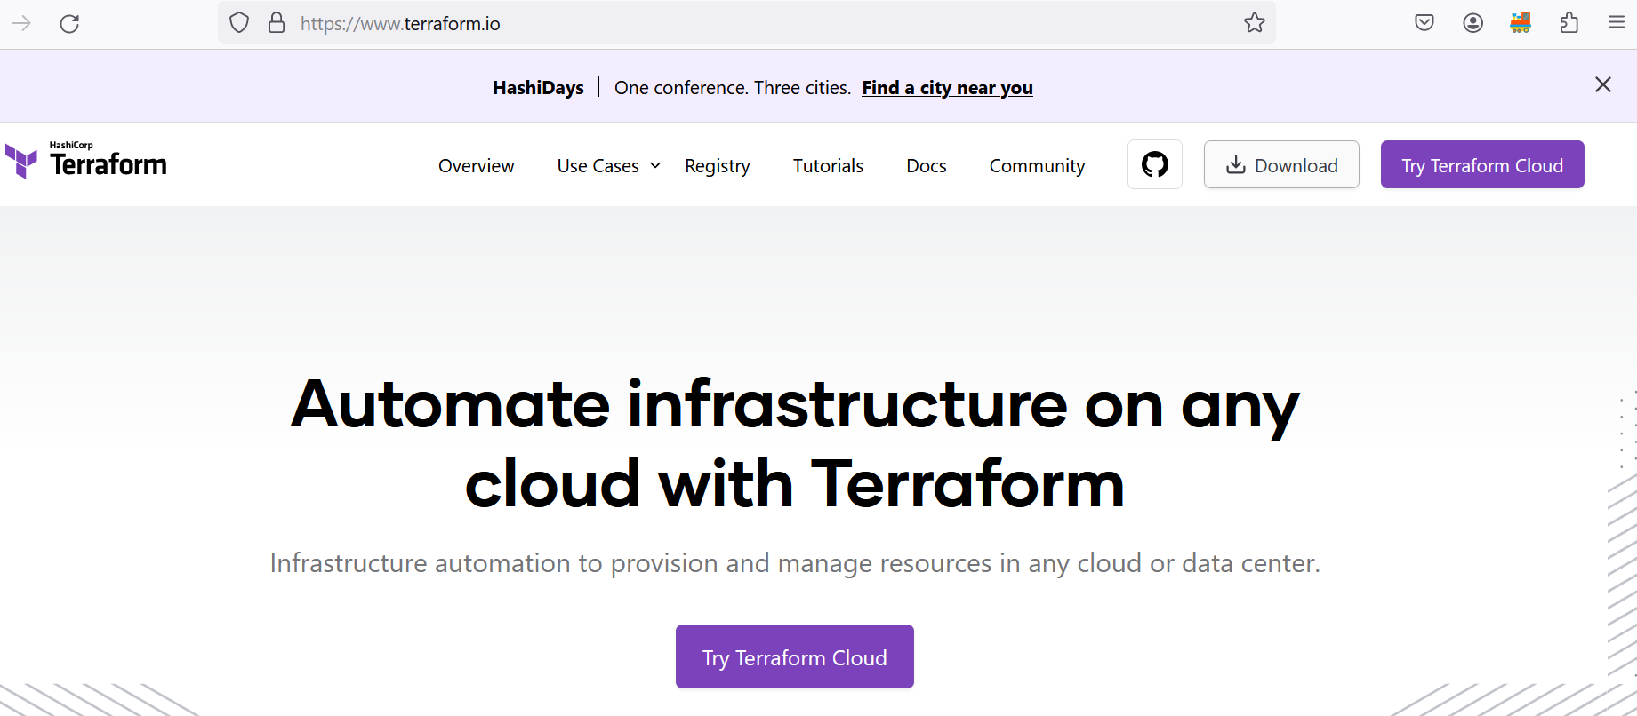
What is Terraform
Automation tool for creating infrastructure on any cloud.

Slide 2
How to do automation?
Follow Terraform documentation. Terraform provides very good documentation that you need to follow blindly.
Terraform URL: https://www.terraform.io/

Slide 3
Terraform core concept
Resource: This is the infrastructure which you want to create
Provider: This refers to where you want to create infrastructure
Argument: The inputs which we express in terraform are called as arguments
Output: The output given by terraform is referred as attribute

Slide 4
Main.tf
In main.tf we are writing our need, and it is referred as desire state.
Note: in main.tf we write what we want.

Slide 5
terraform fmt
The terraform fmt command is used to rewrite Terraform configuration files to a canonical format and style.

Slide 6
terraform validate
The terraform validate command validates the configuration files in a directory, referring only to the configuration and not accessing any remote services such as remote state, provider APIs, etc.

Slide 7
terraform init
The terraform init command initializes a working directory containing Terraform configuration files. This is the first command that should be run after writing a new Terraform configuration or cloning an existing one from version control. It is safe to run this command multiple times.

Slide 8
terraform plan
The terraform plan command creates an execution plan, which lets you preview the changes that Terraform plans to make to your infrastructure. By default, when Terraform creates a plan it:
Reads the current state of any already-existing remote objects to make sure that the Terraform state is up-to-date.
Compares the current configuration to the prior state and noting any differences.
Proposes a set of change actions that should, if applied, make the remote objects match the configuration.

Slide 9
terraform apply
The terraform apply command executes the actions proposed in a Terraform plan to create, update, or destroy infrastructure.
When we run terraform apply command statefile would be getting generated.

Slide 10
terraform destroy
The terraform destroy command is a convenient way to destroy all remote objects managed by a particular Terraform configuration.

Slide 11
Core concept
In Terraform we write in main.tf file what we want.
When we run terraform apply command statefile would be created.
Once terraform apply is done, infrastructure would be created in cloud service provider.
Summary :In Terraform configuration information is available in 3 place

Slide 12
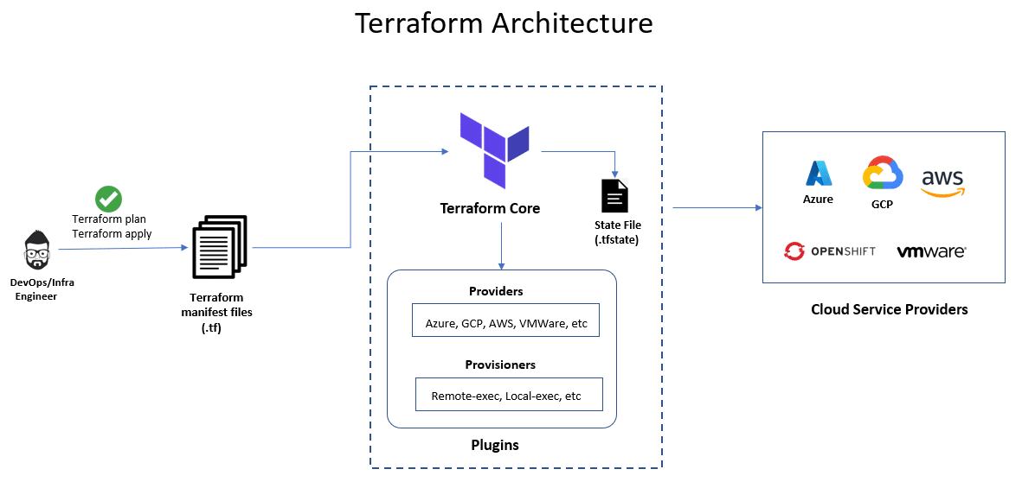

Slide 13
Terraform core
Terraform’s core (also known as Terraform CLI) is built on a statically-compiled binary that’s developed using the Go programming language.
This binary is what generates the command line tool (CLI) known as “terraform,” which serves as the primary interface for Terraform users. It is open source and can be accessed on the Terraform GitHub repository.

Slide 14
Providers
Terraform providers are modules that enable Terraform to communicate with a diverse range of services and resources, including but not limited to cloud providers, databases, and DNS services.
Each provider is responsible for defining the resources that Terraform can manage within a particular service and translating Terraform configurations into API calls that are specific to that service.
Providers are available for numerous services and resources, including those developed by major cloud providers like AWS, Azure, and Google Cloud, as well as community-supported providers for various services. By utilizing providers, Terraform users can maintain their infrastructure in a consistent and reproducible manner, regardless of the underlying service or provider.

Slide 15
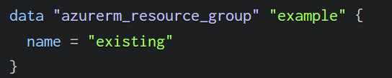
Data Block
A data block is used to fetch data from the provider’s services, which can be used in resource blocks. It includes the data type and configuration details.
This is used in scenarios where the resource is already deployed, and you would like to fetch the details of that resource.
The code snippet below helps you to fetch details of an existing resource group that is already deployed.

Slide 16
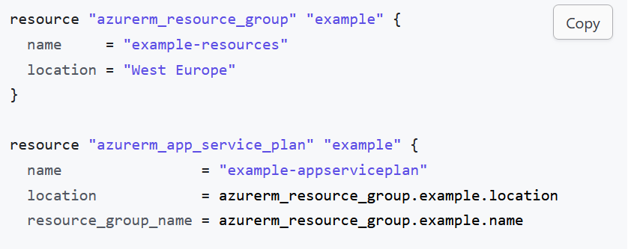
Reading data by dot convention

